Slide 1
TORONTO POLICE Traffic Services – Safety Programs
Notes:
Welcome
Introduce yourself:1-2 minute
How long have you worked for TPS?
What department do you work for?
What made you join TPS?

Slide 2
Let’s Chat About
Pedestrian Safety
Impaired Driving
Distracted Driving
Speeding

Slide 3
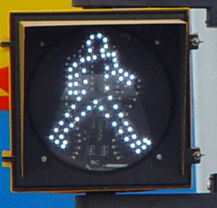
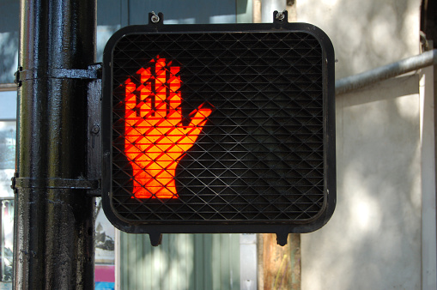
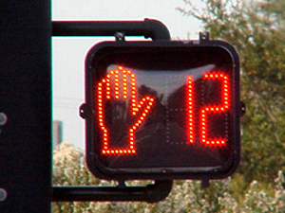
Pedestrians
Notes:
WALK – start crossing and watch for vehicles
DON’T START – BUT FINISH CROSSING IF STARTED – time remaining to finish crossing
DON’T CROSS - stop
NEW RULE – JAN 1, 2016
Drivers must remain stopped at ped crossovers or school crossings or crossing with a guard until the person crossing the street are off the roadway
FINE - $150/$500 3 points
The crosswalk is at an intersection and the crossover is usually mid-block with the yellow lights overhead and the cross symbols on the roadway.
Before traffic had to stop until the peds were halfway across; the new rule now says all vehicles must stop and stay until the peds have left the roadway.
So, you have to wait at a crossover – which doesn’t always have flashing lights – but not at a normal stop sign or red light with painted lines (again, unless there’s a school crossing guard there)
If there’s a crossing guard with their sign out, you can’t turn right, even if there’s no peds in your way.

Slide 4
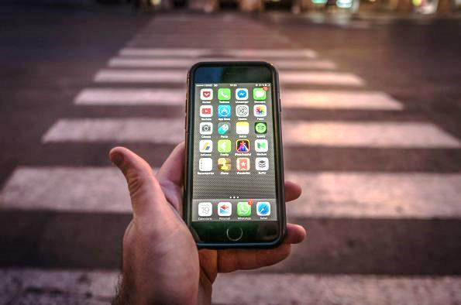
Pedestrians
Notes:
STOP, LOOK and LISTEN
Using the road is a shared responsibility
Stay off your phone – head up
Wear reflective / bright clothing
Obey crossing guards / traffic lights / stop lights
Walk on the part of the sidewalk furthest away from the curb
Walk facing traffic when there are no sidewalks
Never cross in the middle of a block
Remove headphones
Stand back from the roadway until given right of way
Make eye contact with drivers before stepping onto the roadway

Slide 5
Impaired Driving
For the purposes of the Drug Evaluation and Classification (DEC) Program, a drug is defined as:
“any substance, which when taken into the human body, can impair the ability of the person to operate a motor vehicle safely”
Notes:
What does an Impaired Person look, sound and smell like?
Glassy, watery, bloodshot eyes
Loud or soft slurred speech, speaking slowly or repeating themselves a lot
Combative with words or actions
Difficulty performing normal tasks as easily as they can when they are sober. Includes things like walking a straight line, lighting a cigarette properly, spilling drinks, or fumbling with other objects
Inhibitions become lowered
Drowsy, difficulty keeping eyes open
Both alcohol and marijuana have very strong odors that linger with the user long after the intoxicating substance has been consumed
Consider alcohol tolerance. Remember that it's possible for people to develop a tolerance for alcohol, but that doesn't mean that they are not legally intoxicated. It just means that visual recognition is more difficult. For some people with exceptional tolerance, drink counting may be the only way to assess intoxication but this is not without problems

Slide 6
Zero Tolerance
Notes:
Zero BAC is a good policy at any age
Penalties

Slide 7
Arrive Alive
Notes:
Zero BAC is a good policy at any age
Penalties

Slide 8
If it doesn’t make sense here,
why does it make sense when you drive?
Notes:
Ruins your focused. It’s the law of attention, when you’re really aware of some things, you are less aware of others
Slows down your reaction time. What will happen if a car suddenly swerves into your lane?
Makes your mind drift and disturbs your short-term memory. Losing your train-of-thought may not be that important if you’re sitting on a park bench with friends, but it can be dangerous when you’re behind the wheel.
Heightened Sensory Perception (ie. Brighter colours)
Altered perception of time and distance.
How strong is your pot?. Pot strength can vary depending on where it comes from, how it was grown, and what strain it is. The strength of the pot can make a big difference on your driving, especially if you only use it occasionally.

Slide 9
Eggs Are Fragile, So Are We

Slide 10
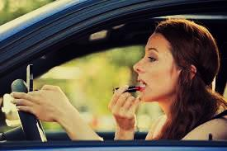
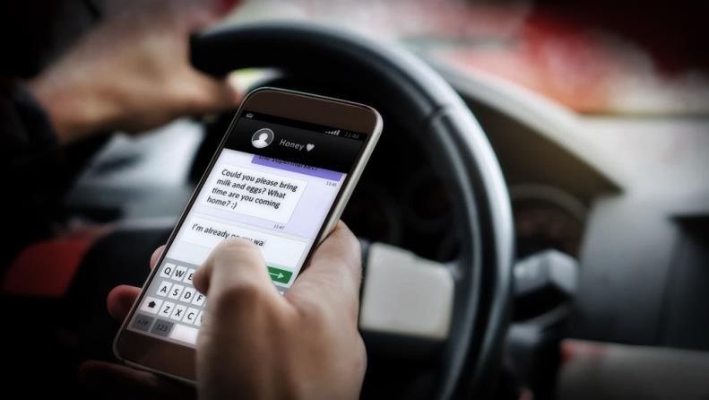
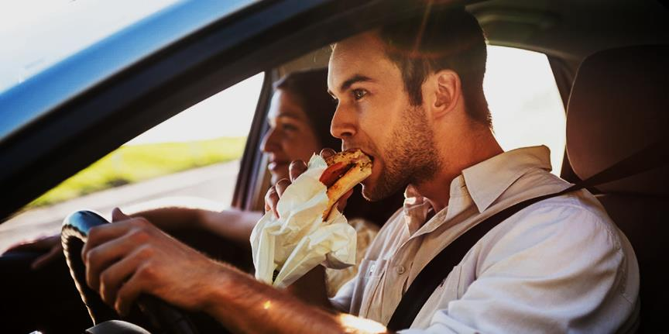
Distracted Driving
There are 3 main types of Distracted Driving:
Notes:
What else makes us distracted?
New distracted driving penalties for Jan 2019

Slide 11
VISUAL: taking your eyes off the road
MANUAL: taking your hands off the wheel
COGNITIVE: taking your mind off what you’re doing

Slide 12
Notes:
Very hard to multi task- especially behind the wheel

Slide 13
Speed
Facts - The Higher The Speed:
The less time the driver has to spot dangerous situations
The greater the time and distance it takes to stop
The greater the chance the car will skid
The greater the force of impact will be in a collision
The greater the personal injuries and property damages are in collisions
Notes:
Race track
Speed limit not posted – assume 50 km/h

Slide 14
Driving Scenario
Notes:
Driving scenario – pulled over for a standard ride check
4 students driving in car.
Get pulled over for XXXX
Officer discovers driver was/is XXXX
Perform Standardize Field Sobriety Testing while student wears impaired goggles
Simulate being arrested
Explain penalties for each
Standardize Field Sobriety Testing - Is set of tests, commonly referred to as SFST, has three components:
The Horizontal Gaze Nystagmus Test, which involves following an object with the eyes (such as a pen or other stimulus) to determine characteristic eye movement reaction to the stimulus
2. The Walk-and-Turn Test (heel-to-toe in a straight line). This test is designed to measure a person's ability to follow directions and remember a series of steps while dividing attention between physical and mental tasks.
3. The One-Leg-Stand Test

Slide 15
Notes:
Driving scenario – pulled over for a standard ride check
4 students driving in car.
Get pulled over for XXXX
Officer discovers driver was/is XXXX
Perform Standardize Field Sobriety Testing while student wears impaired goggles
Simulate being arrested
Explain penalties for each
Standardize Field Sobriety Testing - Is set of tests, commonly referred to as SFST, has three components:
The Horizontal Gaze Nystagmus Test, which involves following an object with the eyes (such as a pen or other stimulus) to determine characteristic eye movement reaction to the stimulus
2. The Walk-and-Turn Test (heel-to-toe in a straight line). This test is designed to measure a person's ability to follow directions and remember a series of steps while dividing attention between physical and mental tasks.
3. The One-Leg-Stand Test

Slide 16
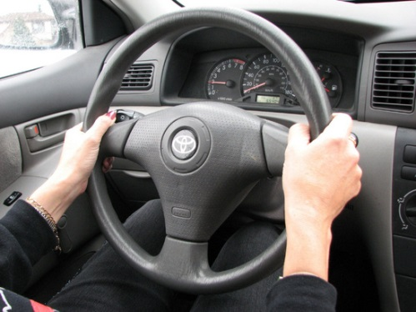
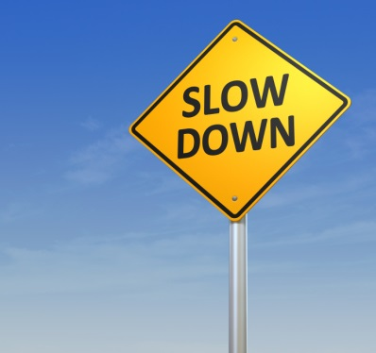
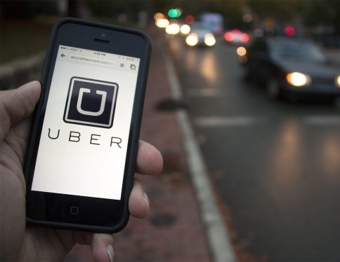
Key Messages
Be Safe, Be Seen
Eyes on road, hands on the wheel
Speed Kills – Slow it down
Plan While You Can

Slide 17
Questions?
Notes:
Questions
What is the hardest part of your job?
How do you cope with the stress of your job?
How do you balance work/home?

